Slide 1
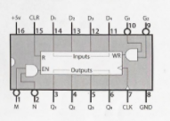
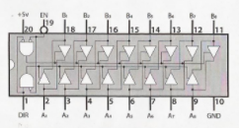
Ben Eater’s 8 Bit Computer
A
74LS245:
8-bit bus transceiver
A
74LS173:
4-bit D register
74LS173:
4-bit D register
B
74LS245:
8-bit bus transceiver
B
74LS173:
4-bit D register
74LS173:
4-bit D register

